Slide 1
Book-Writing Cohort
With Dr. Rhonda Alexander
WEEK 5

Slide 2
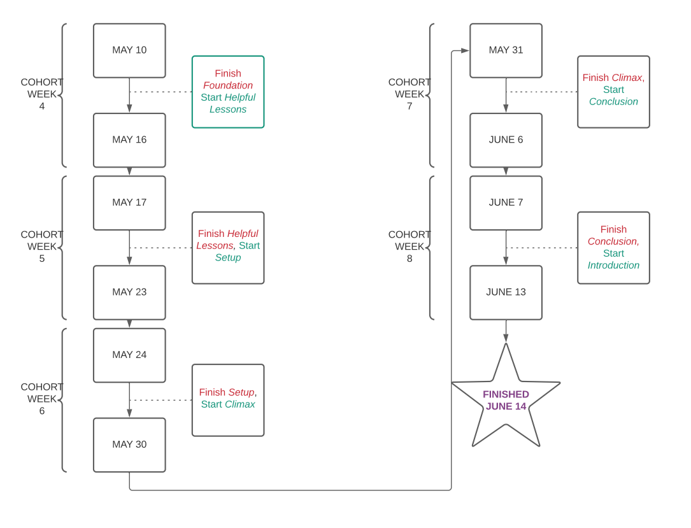
REMAINING SCHEDULE

Slide 3
THE SET UP
Energizes your reader and prepares them for the “big reveal” in the climax
Explains to readers how this concept/formula/idea/method/mindset shift changed your life
Pulls reader into the notion that their life is about to change for the better

Slide 4
BUILD THE EXCITEMENT
Explain the basis or components of the transformation (why should this work for others?)
Are there any building blocks? Special definitions? New concepts?
Connect it to how your life changed

Slide 5
MAKE THEM WANT TO CHANGE
Think about how you want people to feel at this stage of the book.
Consider the information/ experiences you needed to have to get to the transformation
Give them all the background they need to prepare for the changes you’re going to tell them to make in the next chapter/section.

Slide 6
THE WEEK AHEAD
If you’re behind schedule, re-adjust your writing plan/word count goals
Celebrate at least one (1) writing win in the Get It Done! FB Group
Finish the “Helpful Information” chapter(s) of your manuscript.
Work on the Setup chapter(s)

