Slide 1
Book-Writing Cohort
With Dr. Rhonda Alexander
WEEK 7

Slide 2
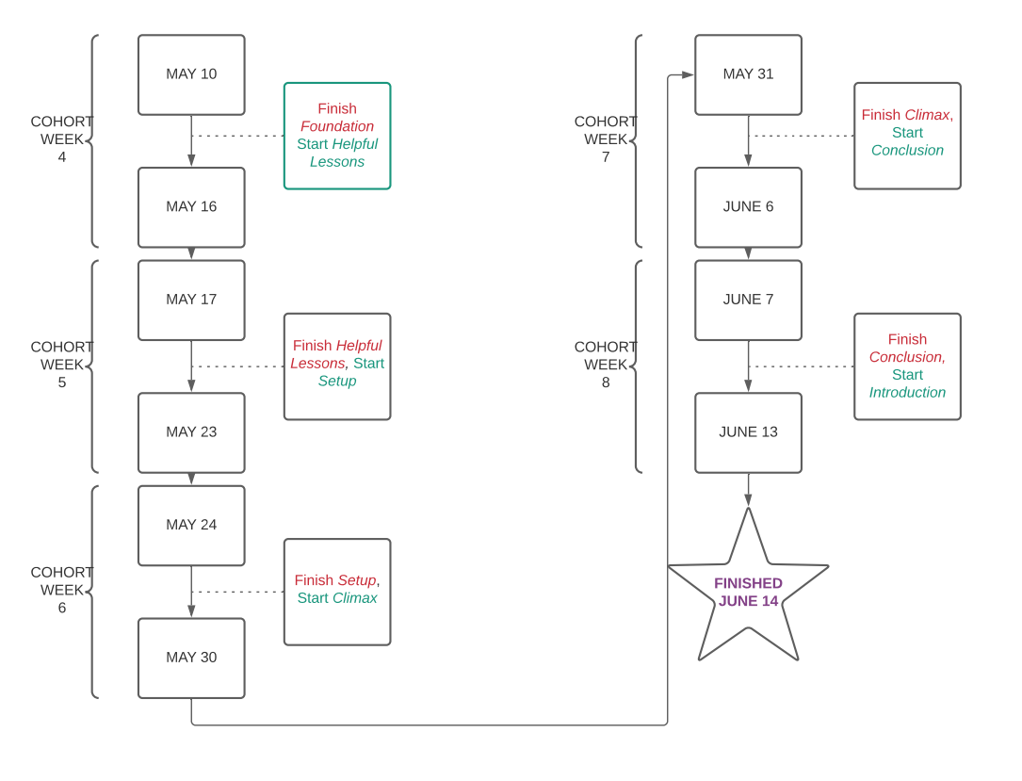
REMAINING SCHEDULE

Slide 3
NOW …isn’t the time to give up!
If you’re behind, stop and think about a plausible, new deadline
What do you need to finish this project?

Slide 4
IF YOU’RE ON TRACK…
Let’s stop and take a moment to celebrate!

Slide 5
IN EITHER CASE
Appreciate how far you’ve come!
From afraid to begin, to fully involved and committed to this project
You CAN finish this!

Slide 6
THE WEEK AHEAD
Renew your commitment to yourself to finish as close to June 14th as possible, if you’re going to miss the deadline.
DO NOT GIVE UP.
Complete this statement in the FB group: “During this writing process, my biggest challenge was ________, but I overcame it by ________.”

